Slide 1



National Science Foundation
Cybercorps®
Scholarship For Service
Websites:
https://sites.google.com/binghamton.edu/ciac/scholarship-for-service
https://sfs.opm.gov/
Cybercorps® SFS

Slide 2
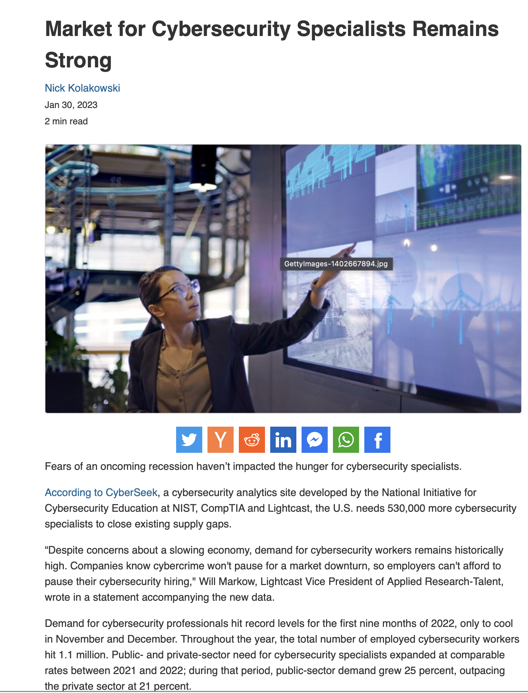
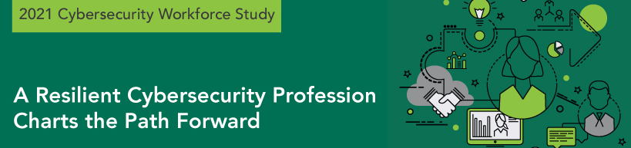
Cybersecurity: A National Priority
Critical to maintain the safety and integrity of our nation’s cyber infrastructure.
Every government agency is now a tech agency.
The cybersecurity workforce in the United States saw a 30% increase in 2021.
However, over 530,000 cybersecurity positions remained unfilled in the United States in 2023.
https://www.dice.com/career-advice/market-for-cybersecurity-specialists-remains-strong

Slide 3
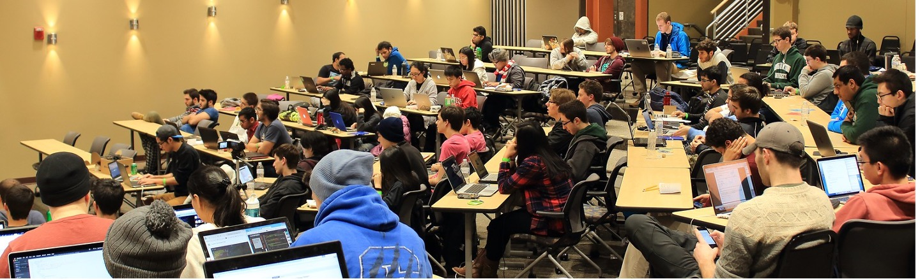
Binghamton’s SFS Program
$3.5 million five-year grant from the NSF to fund SFS Scholars.
The goal is to train highly skilled cybersecurity professionals for entry into the government workforce and for long-term success in cybersecurity careers.

Slide 4
SFS Benefits to You
The SFS scholarship will cover:
Tuition + part of fees
Stipend
$25,000 stipend per year for undergrads in 4+1 program
$34,000 stipend per year for graduate students
Up to 3 years of funding
Plus up to $6,000 per year for related expenses
SFS Job Fair, conferences, bootcamp, research materials and supplies, laptop, books, professional cybersecurity training and certifications, etc.
Note: Like any income, portions of the SFS scholarship may be taxable.
Notes:
Typically the stipend is taxable, but the tuition and fee, and the allowance are not.

Slide 5
Your Service Commitment
Commit to work in a cybersecurity position upon graduation for
government organization
national laboratory
an SFS institute
for a period of time equal to the period of funding.
Seek and join a summer internship each year with a government agency during SFS scholarship.
The OPM hosts two job fairs for SFS scholars each year.
Each government organization has an SFS point of contact whom scholars can connect with.
SFS Faculty will assist scholars on job/internship search and placement.

Slide 6
Eligibility
U.S. citizen.
full-time 4+1 undergrad (GPA 3.3 or better) OR
full-time MS student OR
full-time PhD student working on cybersecurity
Undergrad/MS students must be enrolled in one of the following cybersecurity programs:
Cybersecurity Track (CS, recommended)
Information Assurance Area of Specialization (ECE), or
Advanced Certificate in Cybersecurity (CS & ECE)
4+1 students can be supported in Senior year + MS year.
Willingness & ability to obtain a security clearance, if needed.

Slide 7
SFS Scholars: Training
Cybersecurity courses
Architectural support for security
Software & systems security
Malware analysis
AI-based security
Mobile and IoT security
Steganography Steganalysis Forensics
Privacy
Cybersecurity ethics and education
Online cybersecurity certifications (Paid for by SFS)
Research training
Each scholar will be assigned one or more faculty mentors.
Work with the faculty mentor on a cybersecurity related project through
MS project/thesis
independent study
Ph.D. dissertation.
Attend cybersecurity conferences, seminars, training

Slide 8
SFS Scholars: Training
Hands-on training: Capture The Flag (CTF) club, cybersecurity competitions.
Career training: ethics, communication, writing, presentation, critical thinking, and teamwork.
K-12/Community outreach: make an impact on community

Slide 9
Scholar Appointment and Repayment
Each scholar needs to complete the service agreement questionnaire and sign the OPM service agreement
Satisfy academic/service requirements to avoid repayments (>95% success rate so far for SFS program)
Repayment situations
failing to fulfill the post-award employment obligation
declaring intent not to fulfill the post-award employment obligation
dismissal from the university for disciplinary reasons
withdrawal from the degree program before completing the program

Slide 10
Top SFS employers
National Security Agency (NSA)
Central Intelligence Agency (CIA)
Federal Bureau of Investigations (FBI)
Air Force/DoD Research Labs
MITRE
Department of Navy/Homeland Security/State
Department of Defense/Commerce/Justice
Sandia/Lincoln/Pacific Northwest/Los Alamos/Idaho National Labs
State/local governments
NASA, MIT Lincoln Labs
Office of Inspector General in every government agency.

Slide 11
Interested? Apply!
Apply by March 31st 2023 for early consideration:
https://sites.google.com/binghamton.edu/ciac/scholarship-for-service
Contact us!
Ping Yang, pyang@binghamton.edu (Lead)
Kartik Gopalan, kartik@binghamton.edu
Dmitry Ponomarev, dponomar@binghamton.edu
Aravind Prakash, aprakash@binghamton.edu
Yu Chen, ychen@binghamton.edu
Jessica Fridrich (ECE): fridrich@binghamton.edu
Guanhua Yan (CS): ghyan@binghamton.edu
Lijun Yin (CS): lijun@cs.binghamton.edu
Cybercorps® SFS

